Slide 1
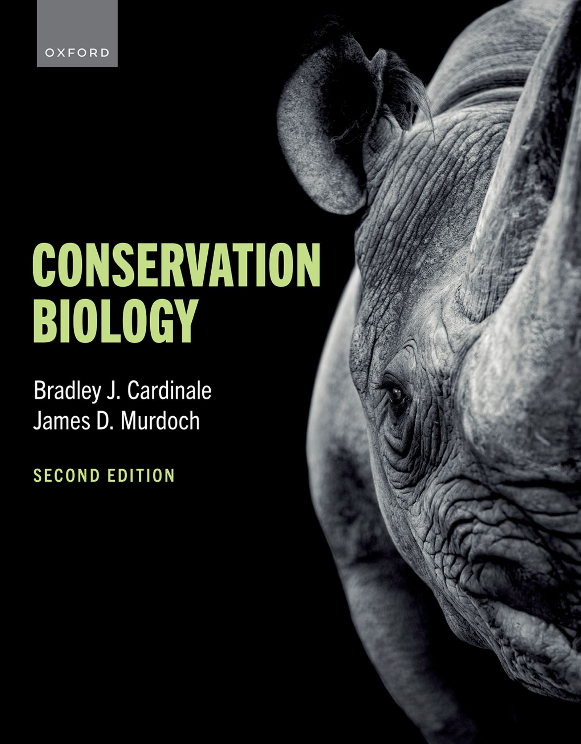
CONSERVATION BIOLOGY
By Bradley J. Cardinale and James D. Murdoch

Slide 2
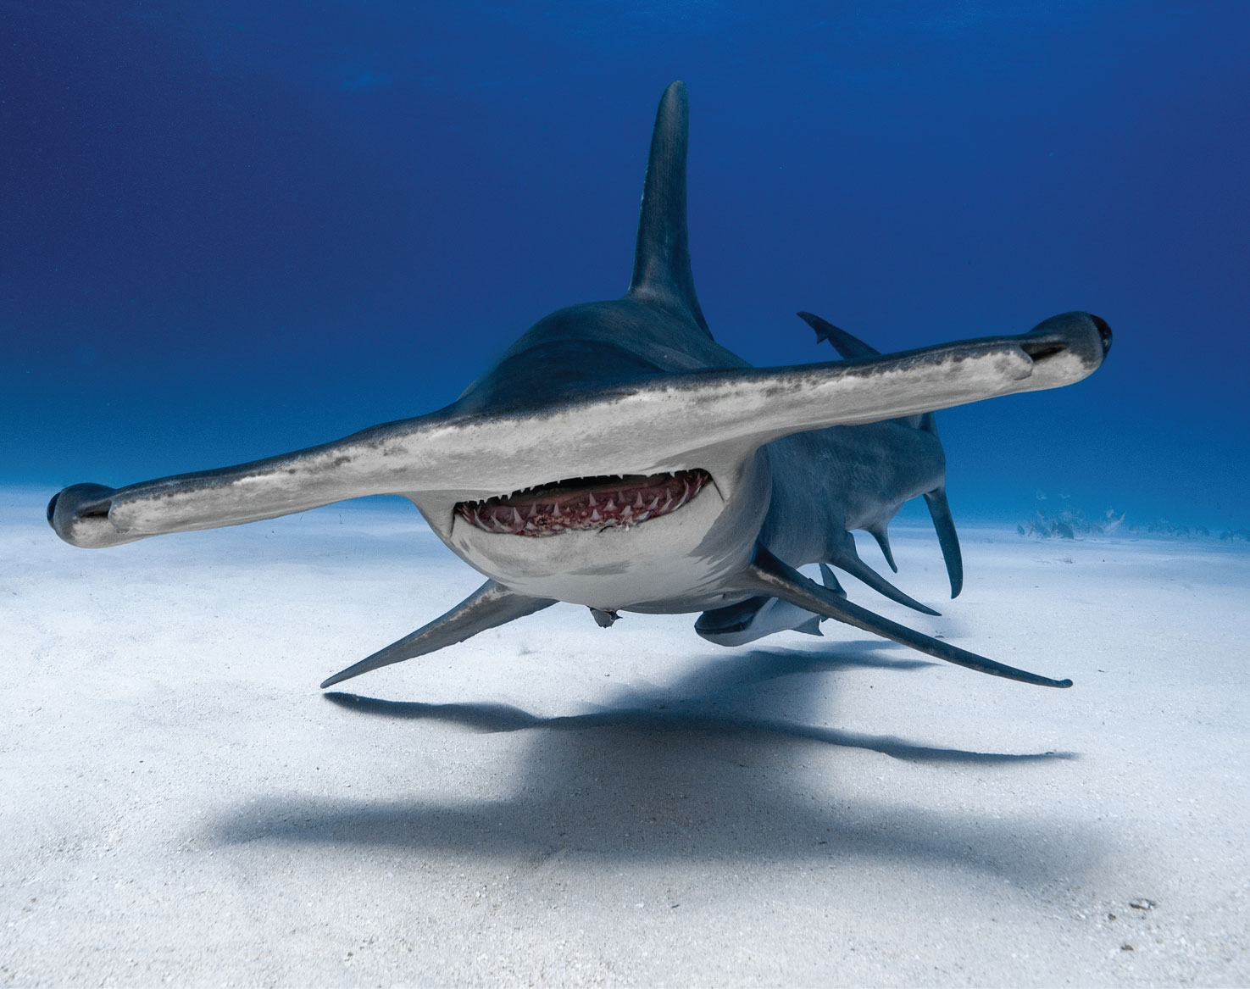
2
Notes:
The great hammerhead (Sphyrna mokarran) is the largest species of hammerhead shark, attaining lengths up to 6.1 m (20 ft). It is found in tropical and warm temperate waters worldwide, where it is critically endangered because of overfishing.

Slide 3
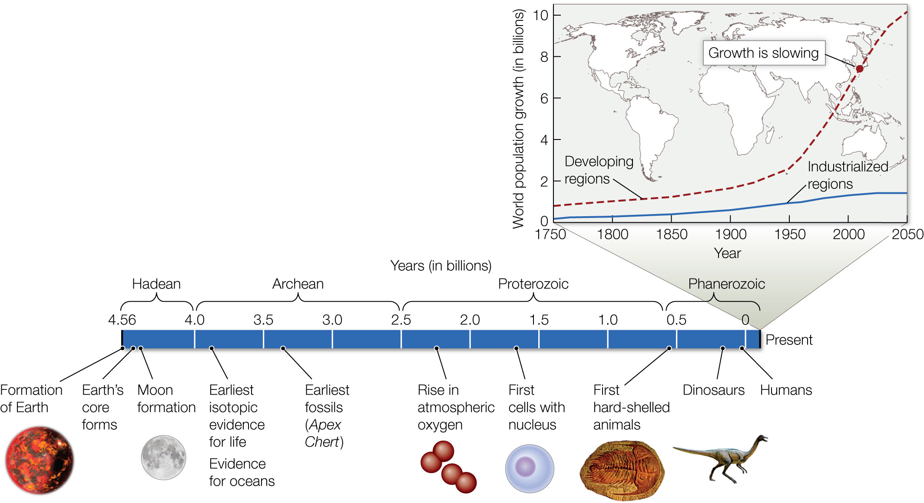
Figure 1.1 Human dominance is but a small fraction of Earth’s 4.6-billion-year history.
Notes:
Figure 1.1 Human dominance is but a small fraction of Earth’s 4.6-billion-year history. Although H. sapiens evolved 200,000 years ago, nearly all human population growth has occurred in the past 200 years. Now at 8.1 billion, the population has passed an inflection point where growth in industrial regions of the world is stable (upper graph, solid blue line) and growth in developing regions has slowed and is heading toward a steady state (upper graph, dashed red line).

Slide 4
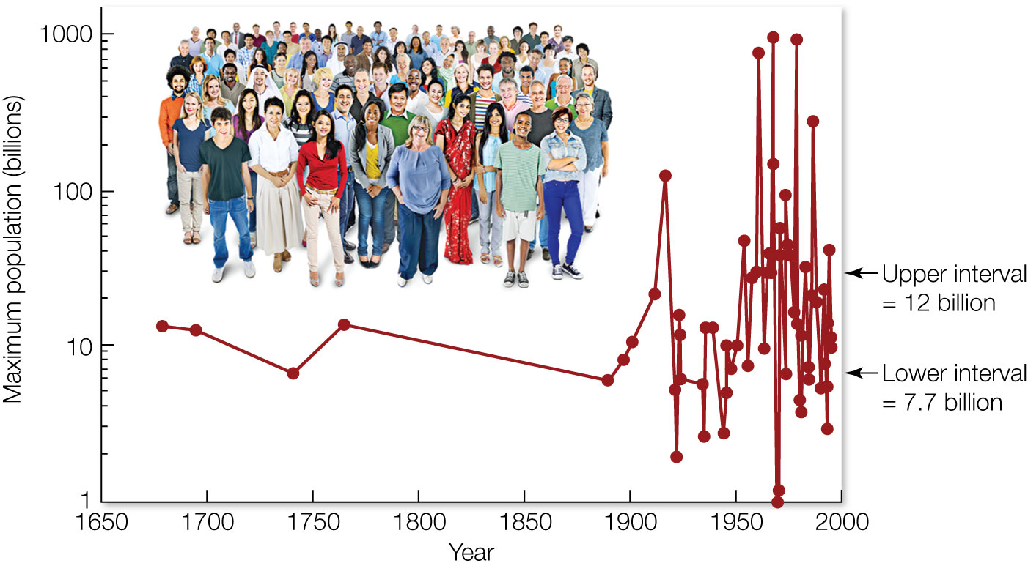
Figure 1.2 This graph shows 65 estimates of Earth’s carrying capacity for humans (y axis, maximum population size) that have been published over time (x axis, year of publication).
Notes:
Figure 1.2 This graph shows 65 estimates of Earth’s carrying capacity for humans (y axis, maximum population size) that have been published over time (x axis, year of publication). The credible interval for these estimates ranges from 7.7 to 12 billion, closely matching the projections from the United Nations of 8 to 16 billion.

Slide 5
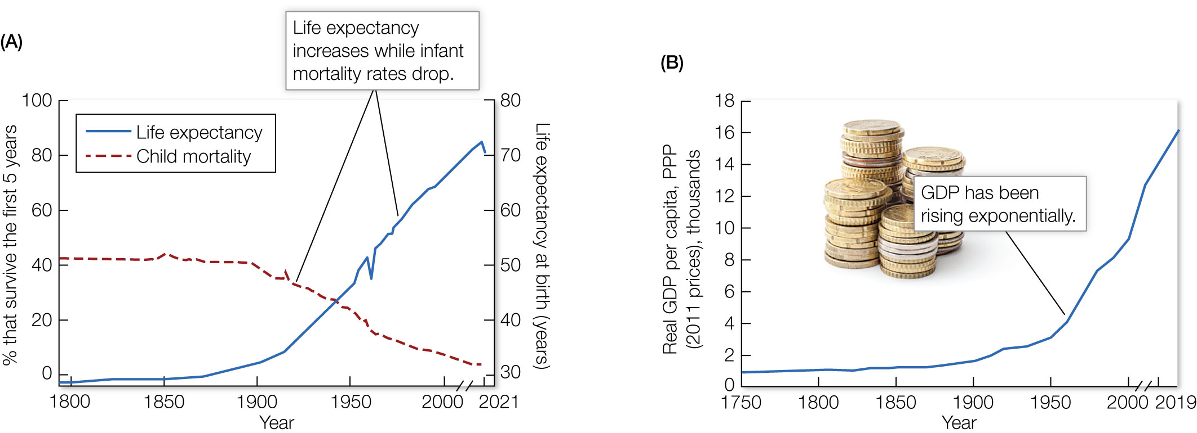
Figure 1.3 The average child born in the modern era will have (A) a greater chance of survival and a higher life expectancy and (B) greater per capita wealth than any generation in human history.
Notes:
Figure 1.3 The average child born in the modern era will have (A) a greater chance of survival and a higher life expectancy and (B) greater per capita wealth than any generation in human history. The resulting population growth and consumption, particularly in developed countries, will be a major challenge for conservation efforts. GDP, gross domestic product; PPP, purchasing price parity.

Slide 6
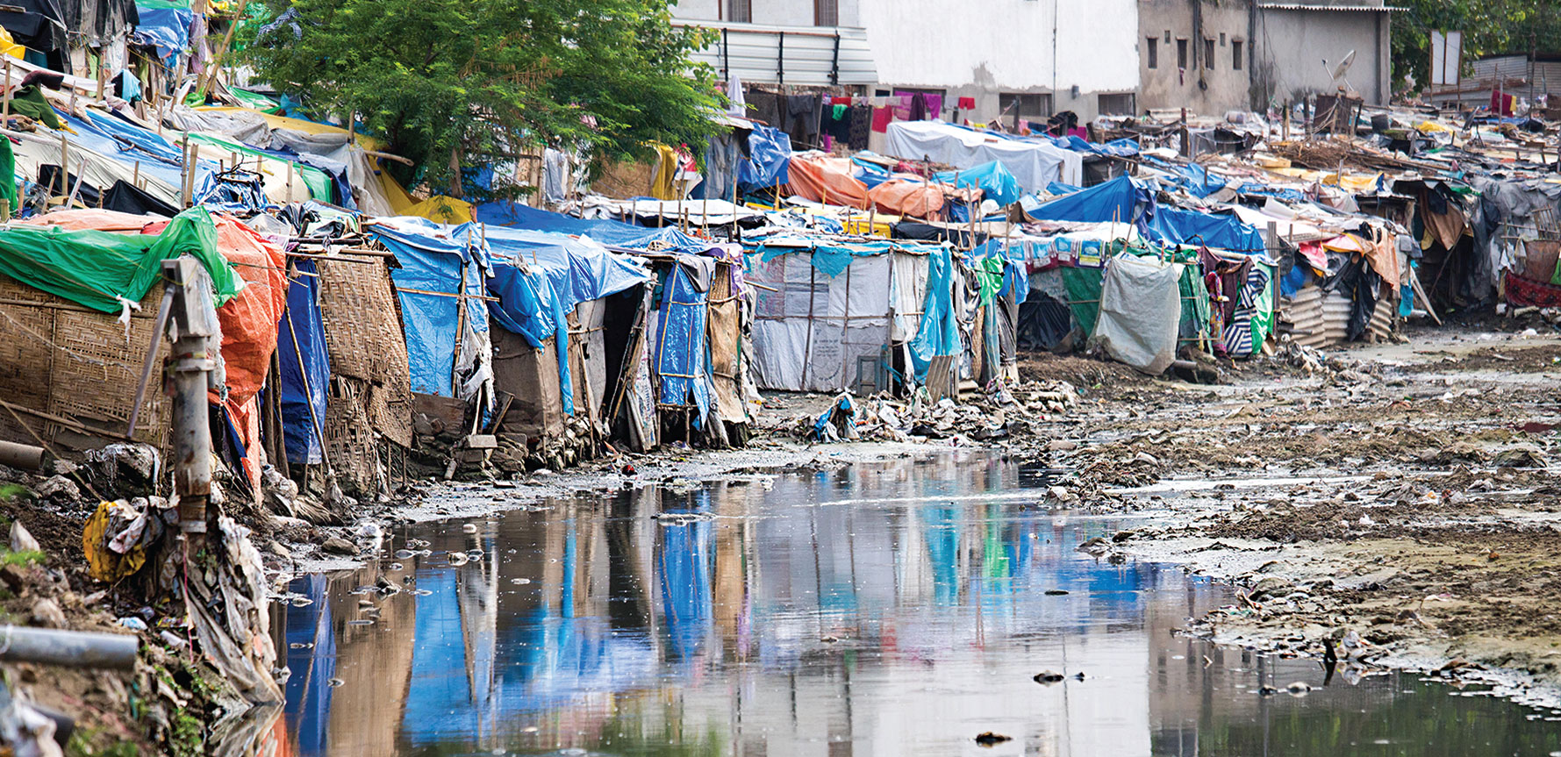
Figure 1.4 While the “average” person born in the modern era will live a longer, healthier, and more prosperous life than their ancestors, more than 1.6 billion people still live in extreme poverty and are malnourished.
Notes:
Figure 1.4 While the “average” person born in the modern era will live a longer, healthier, and more prosperous life than their ancestors, more than 1.6 billion people still live in extreme poverty and are malnourished. People whose basic needs are not met do not have the luxury of caring about biodiversity loss. Therefore, bringing communities out of poverty, particularly in developing nations, will be a major challenge for conservation efforts

Slide 7
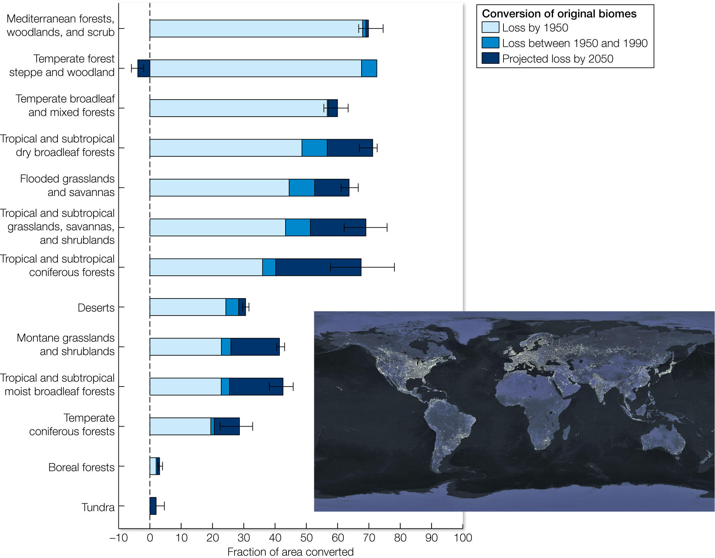
Figure 1.5 This figure shows the fraction of various terrestrial biomes that have been destroyed and converted to other land uses (cultivation, urbanization, etc.).
Notes:
Figure 1.5 This figure shows the fraction of various terrestrial biomes that have been destroyed and converted to other land uses (cultivation, urbanization, etc.). Human transformation of the planet is readily apparent from NASA’s global view of Earth at night, which shows the lights of cities and villages.

Slide 8
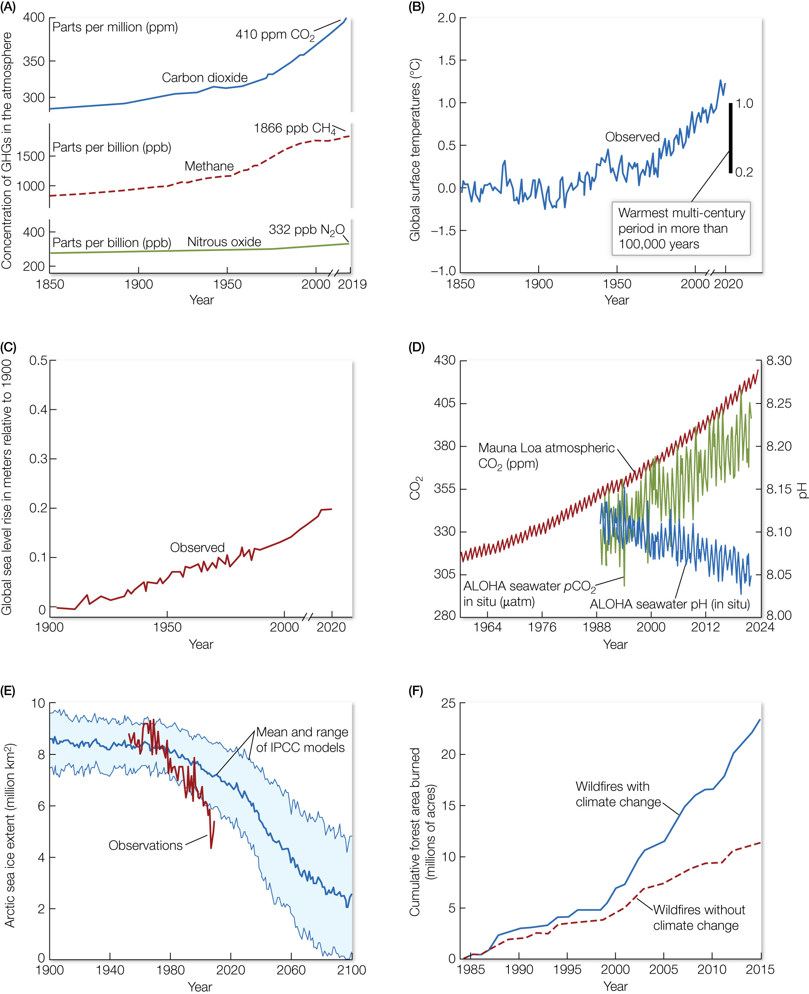
Figure 1.6 Environmental changes associated with (A) increased concentration of various greenhouse gases
Notes:
Figure 1.6 Environmental changes associated with (A) increased concentration of various greenhouse gases and (B) global warming include (C) sea level rise, (D) ocean acidification, (E) reduced ice cover, and (F) an increased severity of wildfires. GHGs, greenhouse gases; IPCC, Intergovernmental Panel on Climate Change.

Slide 9
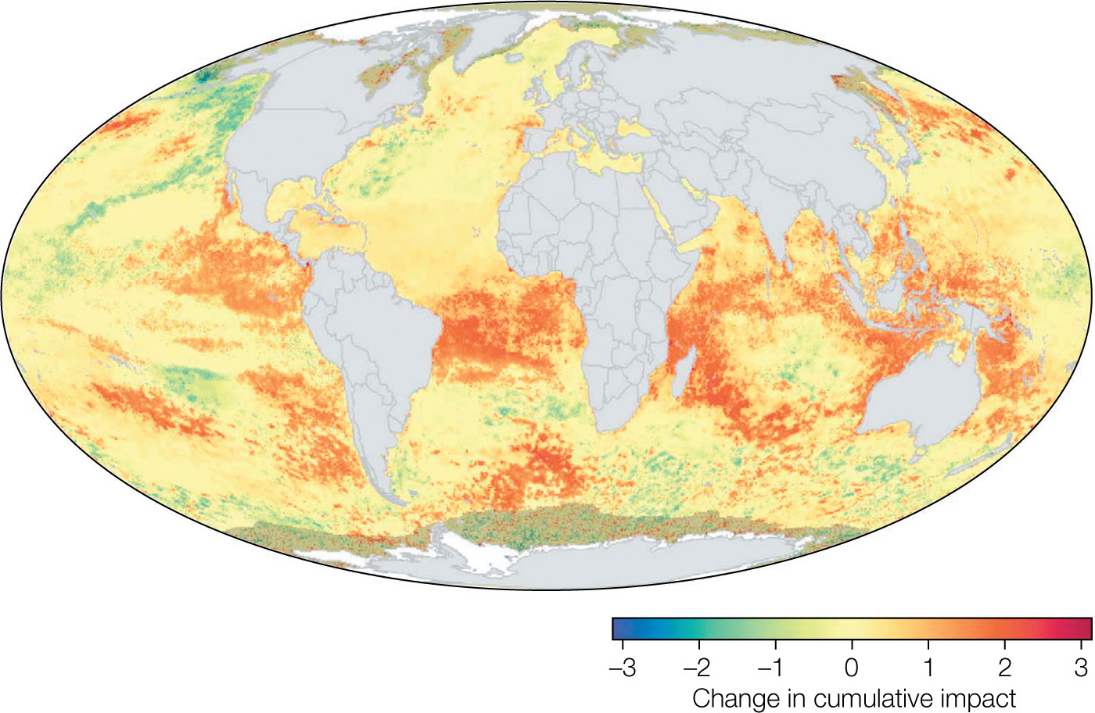
Figure 1.7 In a comprehensive study analyzing changes in Earth’s oceans over a five-year period, researchers found that nearly two-thirds of ocean areas have experienced increased human impact.
Notes:
Figure 1.7 In a comprehensive study analyzing changes in Earth’s oceans over a five-year period, researchers found that nearly two-thirds of ocean areas have experienced increased human impact. This graphic shows the change from 2008 to 2013, with shades of red indicating an increased human impact, while blue shows a decrease.

Slide 10
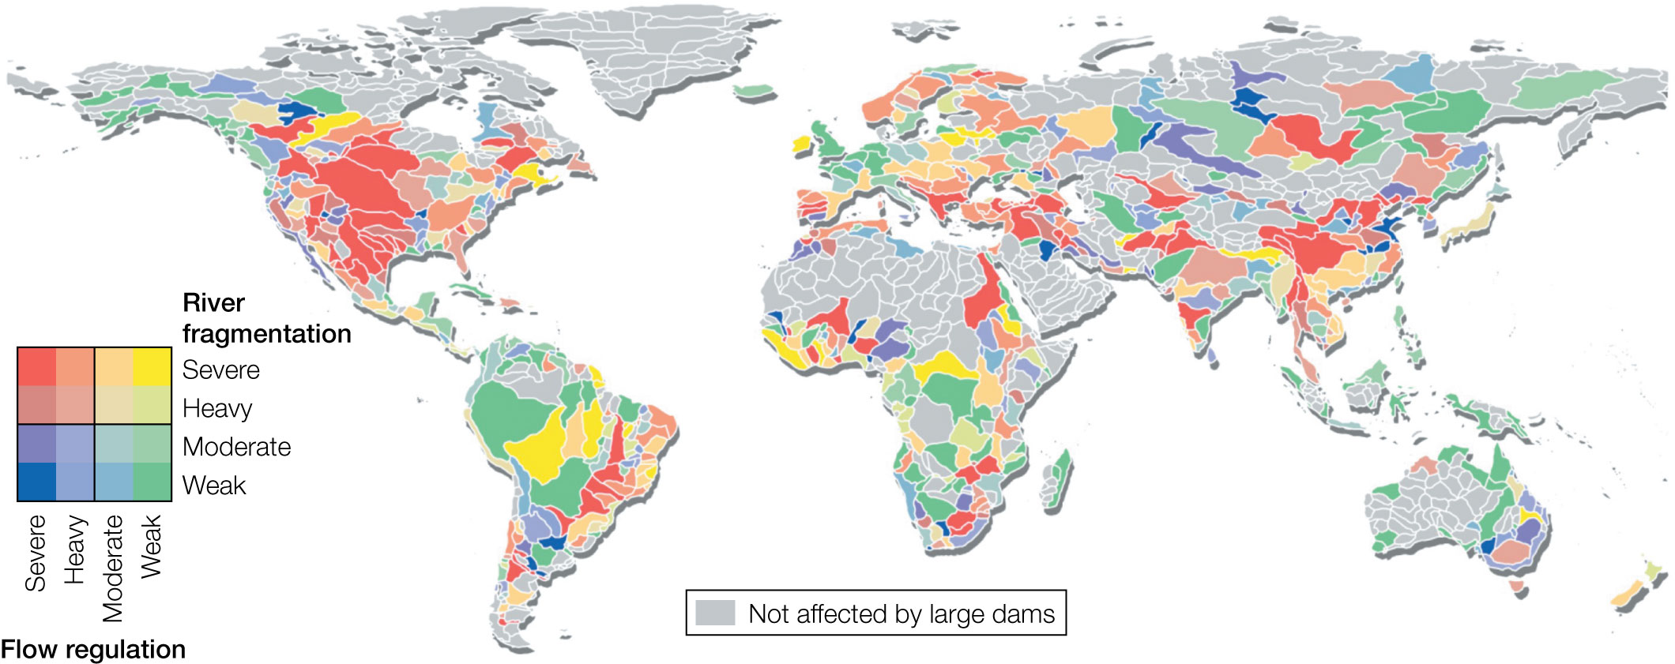
Figure 1.8 This map shows the combined effect of current and future dams on the fragmentation and flow regulation of river ecosystems across the globe.
Notes:
Figure 1.8 This map shows the combined effect of current and future dams on the fragmentation and flow regulation of river ecosystems across the globe.

Slide 11
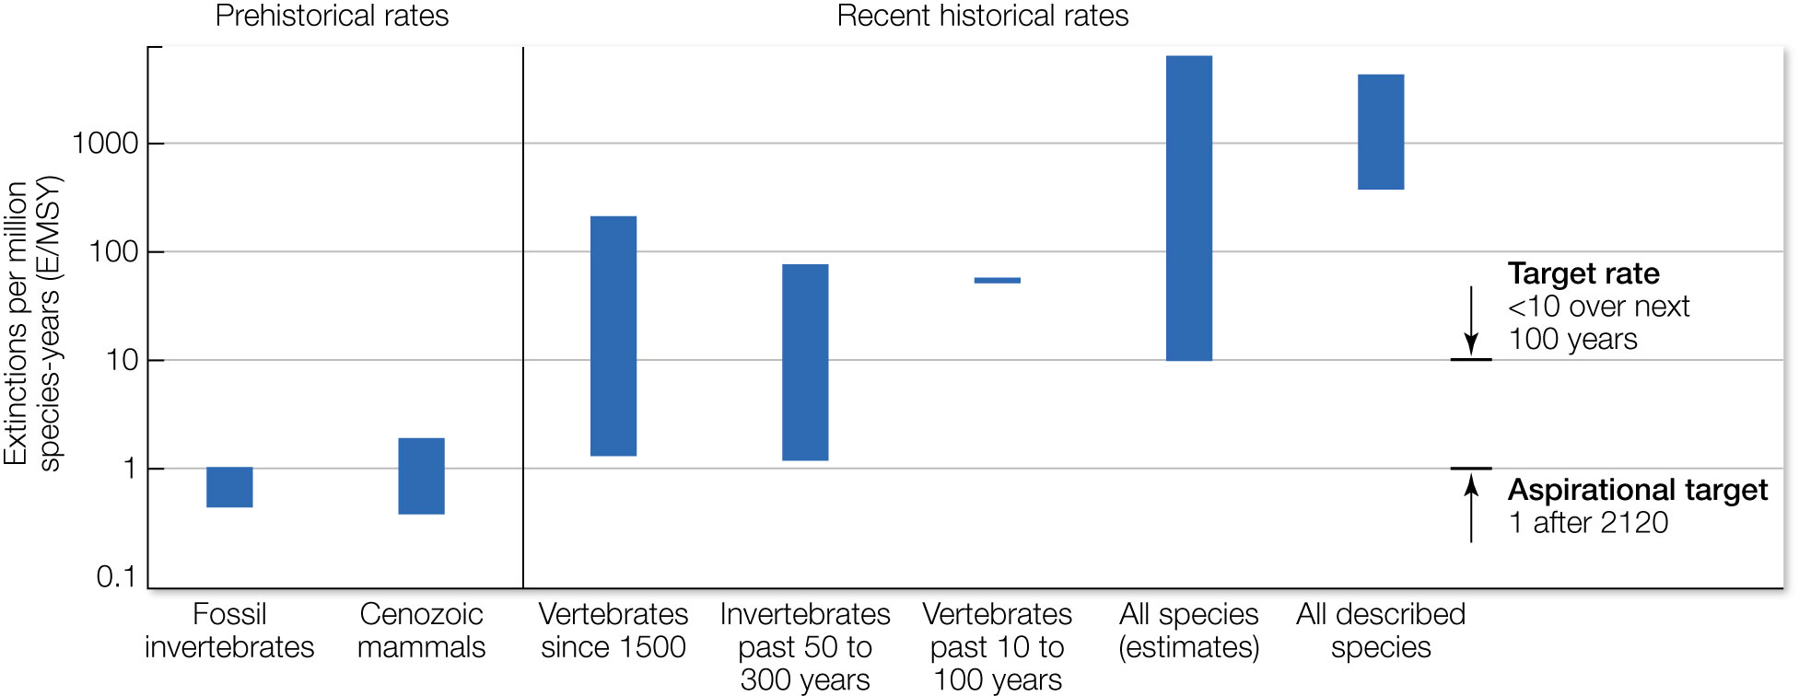
Figure 1.9 Accelerating rates of extinction. Prehistoric rates of extinction recorded in the fossil record for invertebrates (mostly marine species) and mammals in the Cenozoic era averaged roughly 1 extinction per 1,000 species per millennium (left).
Notes:
Figure 1.9 Accelerating rates of extinction. Prehistoric rates of extinction recorded in the fossil record for invertebrates (mostly marine species) and mammals in the Cenozoic era averaged roughly 1 extinction per 1,000 species per millennium (left). Documented rates of extinction for vertebrates and invertebrates over the past few centuries have been 10 to more than 1,000 times higher than prehistoric rates. This has led some to say we have a biodiversity “crisis” and need to reduce extinction rates back to background levels known from the fossil record.

Slide 12
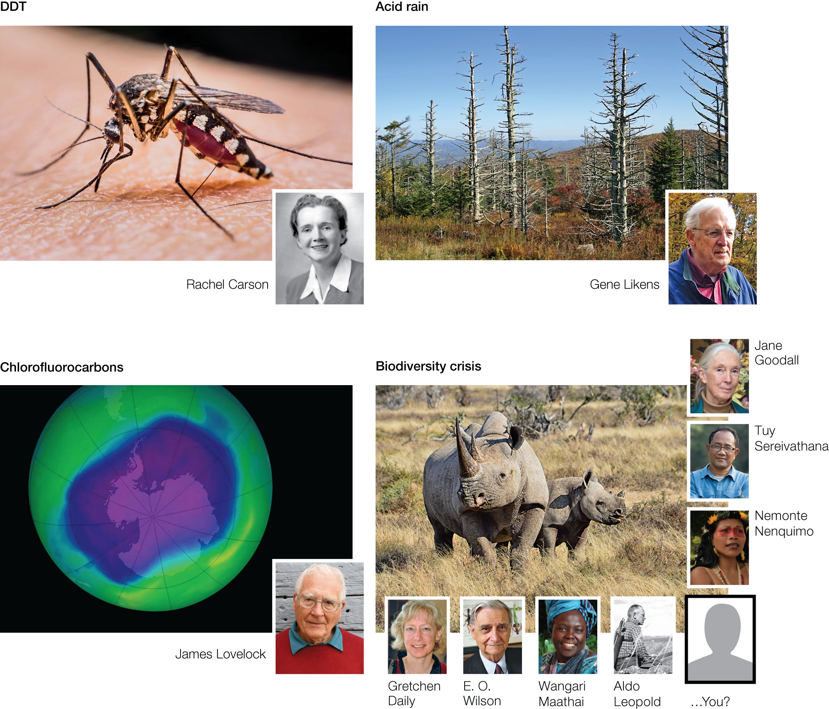
Figure 1.10 Examples of successful efforts to solve global environmental problems like DDT, acid rain, and chlorofluorocarbons, along with the individuals who made the difference.
Notes:
Figure 1.10 Examples of successful efforts to solve global environmental problems like DDT, acid rain, and chlorofluorocarbons, along with the individuals who made the difference. These successes should provide optimism that we can solve the current biodiversity crisis as well.

Slide 13
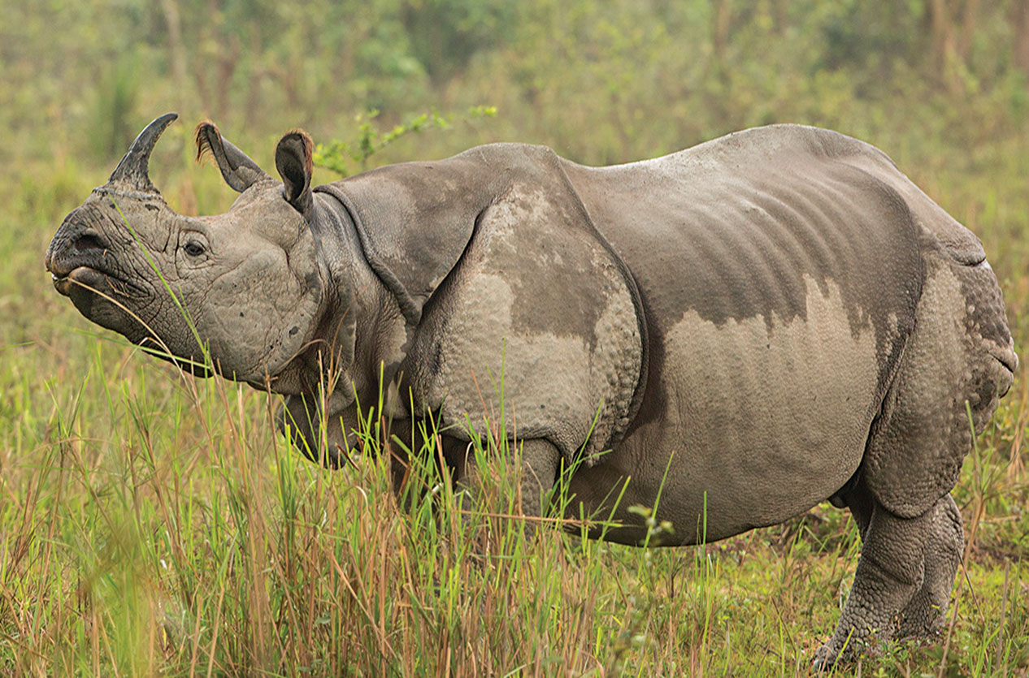
13
Notes:
Indian rhinos, whose numbers had dwindled to only 200 individuals a few decades ago because of poaching, have now bounced back from the edge of extinction thanks to grassroots antipoaching programs.

